Slide 1
Understandig and Predicting Customer Purchase Intent on E-Commerce Platforms Using Machine Learning
Presented By :- Rishu Dixit
Instructor :- Dr. Itauma Itauma

Slide 2

Project Overview Ecommerce
Real-world problem: Predict if a user will purchase during their session
Dataset: 12,330 user sessions from UCI
Approach: Logistic Regression, Decision Tree, Random Forest
Goal: Actionable insights + high accuracy model

Slide 3

Introduction
Online stores lose 18 B $ due to unconverted sessions
(Source Forrester Research Statista Baymard Institute )
Can behavior during a session predict purchase intent?
Prior studies: Neural nets were effective but less interpretable (Sakar et al., 2019)
Our project balances performance and transpare

Slide 4

Dataset & Features
Source: UCI Online Shoppers Purchasing Intention Dataset
Records: 12,330 sessions
Features:
Product & Admin pageviews
Exit/Bounce rates
Session duration
Month, Visitor Type, Weekend

Slide 5
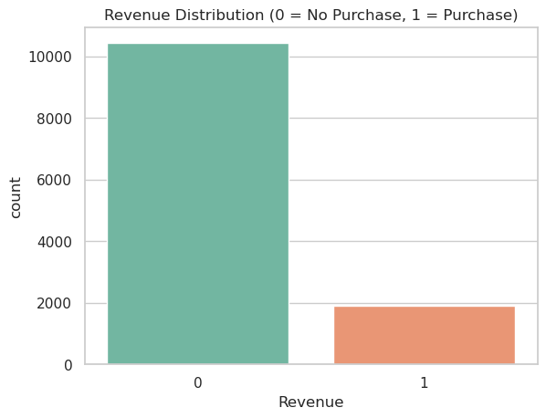
Data Preprocessing & EDA
No missing values
Label Encoding for categorical features
Standardization of continuous features
70-30 Train-Test split (Stratified)

Slide 6
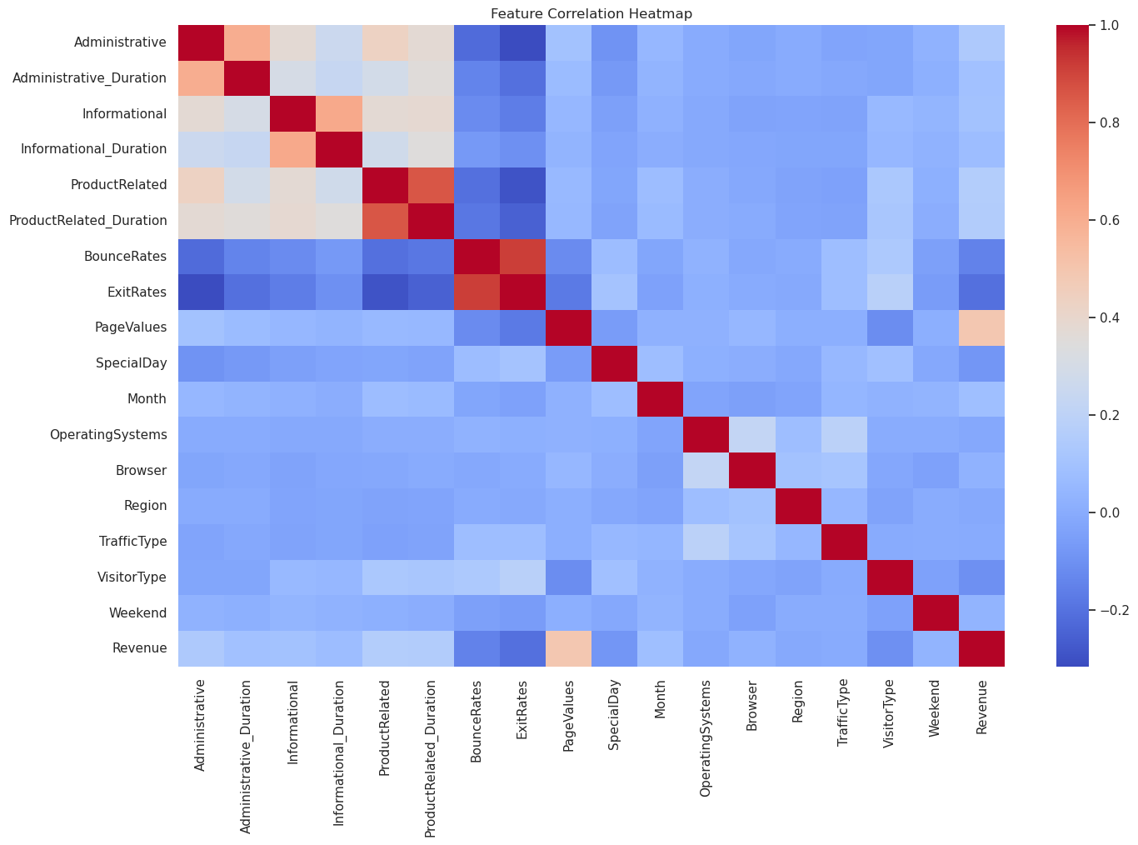
HeatMap

Slide 7
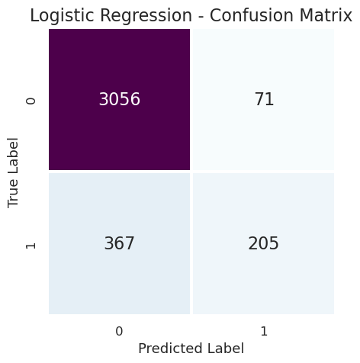
Machine Learning Models
Logistic Regression → baseline model
Decision Tree → better on feature interaction
Random Forest → best performance
Tools used: Python, Scikit-learn, Jupyter Notebook
Tuned with GridSearchCV & 5-fold CV

Slide 8
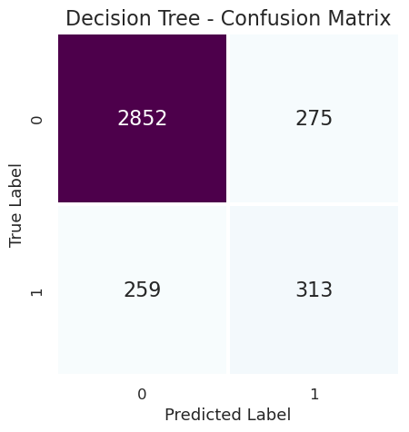
Decision TREE

Slide 9
Results
Model | Accuracy | Precision | Recall | F1-Score | ROC-AUC
Logistic Regression | 84.1% | 72.4% | 68.9% | 70.6% | 0.78
Decision Tree | 86.7% | 75.1% | 72.3% | 73.7% | 0.81
Random Forest | 89.3% | 78.9% | 76.4% | 77.6% | 0.86

Slide 10
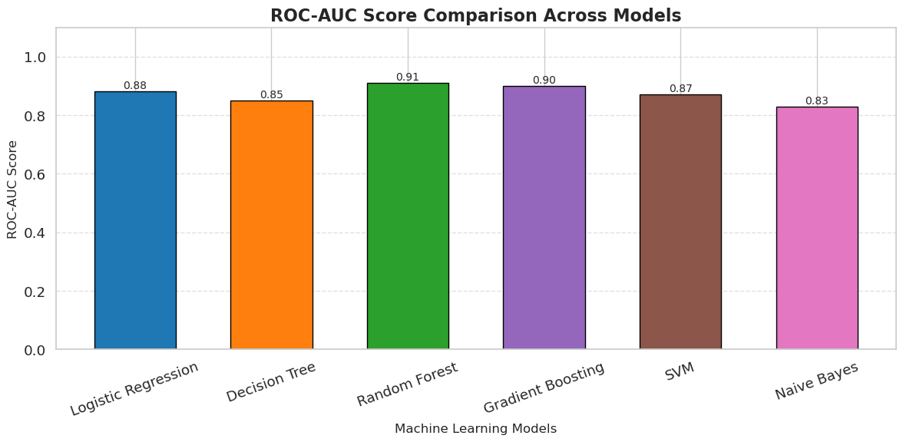
Model Comparison

Slide 11
Challenges & Ethics
Dataset imbalance → handled with stratification & F1-score
Interpretable models preferred for business settings
Ethical concerns:
Transparency
No manipulation
Respect data privacy (Nguyen et al., 2020)

Slide 12
Conclusion & Future Work
ML can predict purchase intent using session data
Random Forest = most accurate + interpretable
Actionable strategy for small e-commerce teams
Future:
Real-time deployment
Deep learning on sequential sessions
Add demographic data

Slide 13
Reference
Sharma, A., Adhikary, A., & Borah, S. B. (2020). Covid-19′ s impact on supply chain decisions: Strategic insights from NASDAQ 100 firms using Twitter data. Journal of business research, 117, 444-449
Sakar, C. O., Polat, S. O., Katircioglu, M., & Kastro, Y. (2019). Real-time prediction of online shoppers’ purchasing intention using multilayer perceptron and LSTM recurrent neural networks. Neural Computing and Applications, 31(10), 6893-6908.
Sakar, C., & Kastro, Y. (2018). Online shoppers purchasing intention dataset. UCI machine learning Repository, 10, C5F88Q.

